Slide 1
AUTONOMOUS VEHICLES
Technologies and Concepts behind
Gauraangi Anand

Slide 2
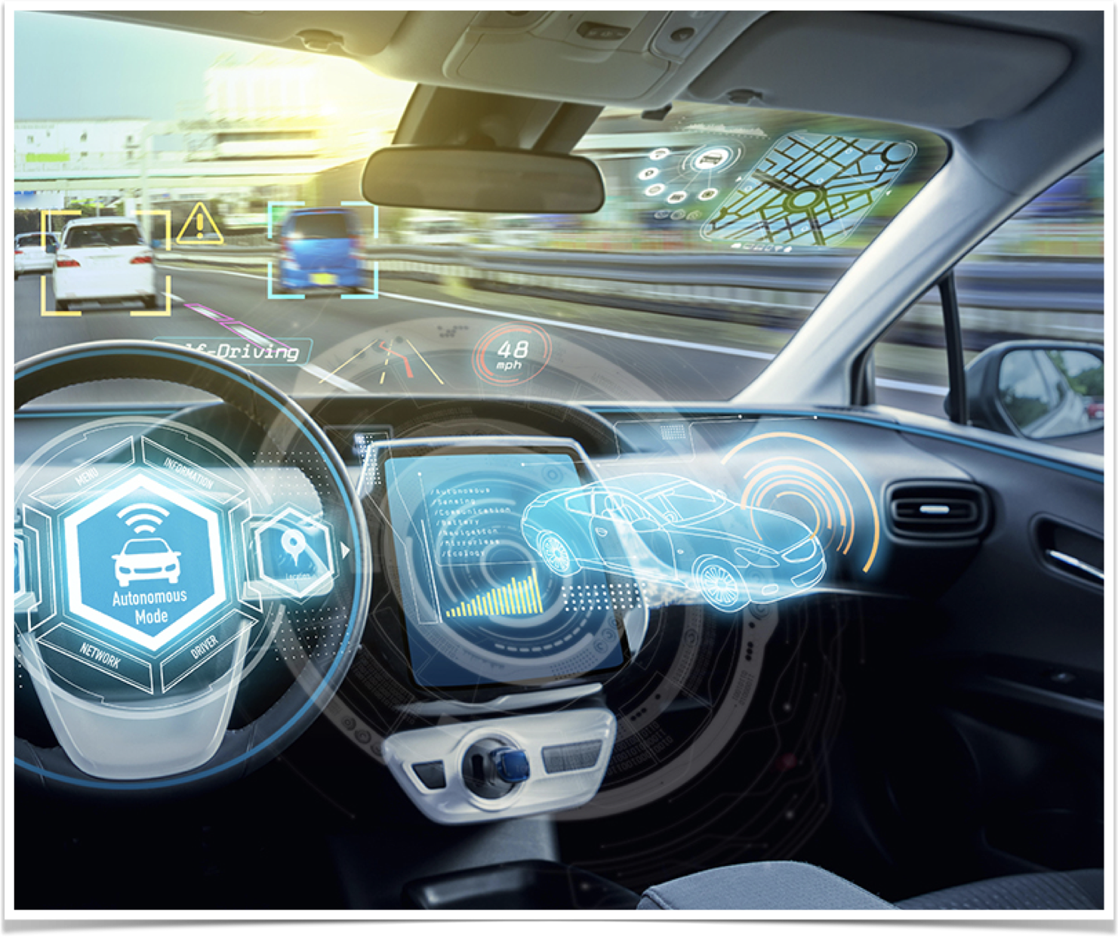
Driven by Tech
There are several critical technologies behind safe and efficient autonomous vehicle operation-
AI,
safety and security,
cameras,
network architecture and infrastructure and
sensor technologies Lidar and radar.
All these technologies must integrate seamlessly to help ensure safe and successful autonomous vehicle operations.

Slide 3
ARTIFICIAL INTELLIGENCE: AI is a major focus for autonomous-vehicle testing and development, and the vehicles are applying AI—a collection of discrete technologies—in new and innovative ways. Experts like Sadana see deep learning as the most significant technology behind autonomous-driving AI. Deep learning, which mimics neuron activity, supports functions like voice and speech recognition, voice search, image recognition and processing, motion detection, and data analysis. Working together, these functions help the vehicles recognize pedestrian traffic, other vehicles on the road, and traffic signals, and adhere to mapped-out routes. Sciarappo compares autonomous-vehicle mapping technology to a “virtual train track.”
SAFETY AND SECURITY: Autonomous vehicles won’t gain widespread acceptance until the riding public feels assured of their safety and security, not only of passengers but also other vehicles and pedestrians. Sciarappo points to the Responsibility-Sensitive Safety (RSS) framework, a safety standard Intel has developed, to help drive this level of acceptance. “The RSS framework is a way for us to start talking about the best practices for keeping cars in safe mode.” To ensure consistently safe operations, autonomous vehicles are equipped with numerous cameras and other types of sensors to carefully monitor the external environment the vehicle is operating in. As the infrastructure grows and becomes more developed, more sensor input will lead to safer operations.

Slide 4
NETWORK INFRASTRUCTURE: Rapid and consistent connectivity between autonomous vehicles and outside sources such as cloud infrastructure ensures signals get to and from the vehicles more quickly. The emergence of 5G wireless technology, which promises high-speed connections and data downloads, is expected to improve connectivity to these vehicles, enabling a wide range of services, from videoconferencing and real-time participation in gaming to health care capabilities such as health monitoring. There are several protocols under which autonomous vehicles communicate with their surroundings. The inclusive term is V2X, or vehicle to everything, which includes:
Vehicle to infrastructure communication, which allows for data exchange with the surrounding infrastructure to operate within the bounds of speed limits, traffic lights, and signage. It can also manage fuel economy and prevent collisions.
Vehicle to vehicle communication, which permits safe operations within traffic situations, also working to prevent collisions or even near misses.
Autonomous vehicle technology resides largely onboard the vehicle itself but requires sufficient network infrastructure.

Slide 5
SENSOR TECHNOLOGY: Sensor systems are rapidly evolving to meet the demands of expanded autonomous-vehicle operations, including radar, lidar, and cameras. These technologies enable the vehicles to operate at five increasingly sophisticated and autonomous levels (as defined by SAE International):
Level 1: Vehicle performs minor steering or acceleration tasks; all other operations are under full human control.
Level 2: Vehicle automatically responds to safety situations, but the driver must remain alert and responsive.
Level 3: Vehicle performs certain “safety-critical functions” under various traffic or environmental conditions.
Level 4: Vehicle can operate without requiring human input.
Level 5: Vehicle operates with full automation in any environment (weather or traffic).
Fred Bower, distinguished engineer at the Lenovo Data Center Group, is also optimistic. “Advances in image recognition from deep-learning techniques have made it possible to create a high-fidelity model of the world around the vehicle,” he says. “I expect to see continued development of driver-assist technologies as the on-ramp to fully autonomous vehicles.”

Slide 6
Exploring the role of Artificial Intelligence
Since autonomous vehicles have to solely depend on algorithmic expertise to manoeuvre past obstacles and follow traffic signals and regulations, the algorithm is bound to incorporate heavily the task of object detection.
This is one of the areas of computer vision that's just exploding and is working so much better than just a couple of years ago. In order to build up to object detection, it is important to explore the concept behind object localisation first.
The problem we have to focus on while exploring the neural network behind an autonomous vehicle is classification with localisation, which means not only do we have to label the recorded image as say a car but the algorithm is also responsible for putting a bounding box around the position of the car in the image. So that's called the classification with localisation problem, where the term localisation refers to figuring out where in the picture is the car we've detective. As is also obvious, it is important that our autonomous vehicle not only recognises that yes there is an obstacle (say another car) present but also knows where it is located to be able to map its way around it and prevent accidents. For an autonomous driving application, we need to detect not just other cars, but also other pedestrians and motorcycles and maybe even other objects. In contrast, in the detection problem there can be multiple objects. And in fact, maybe even multiple objects of different categories within a single image.

Slide 7
In the image classification problem, we input a picture into a ConvNet with multiple layers which results in a vector of features which may be fed into a softmax unit which outputs the predicted class. Let the object categories be:
Pedestrian
Car
Motorcycle
Background (none of the above)
Now if the above provision is to be modified to output even a bounding box around the object so as to localise it, we can change the neural network to have a few more output units that output a bounding box. Now the neural network will output four numbers in the column matrix which can be called bx, by, bh,bw. These 4 numbers parametrise the bounding box of the detected object.

Slide 8
Following convention, the top left corner of the image is considered to be the (0,0) co-ordinate and the bottom right is the (1,1) co-ordinate. To specify the bounding box around the detected object, it is important to specify the midpoint, width and height. The midpoint is denoted by (bx,by), width by bw and height by bh. So, now the neural networks returns not only the class label but also the values of bx,by,bw and bh so as to draw the bounding box around the classified object and localise it. Considering the above mentioned scenario where there were 4 object categories, the output y will be a column matrix:
y= [pc bx by bh bw c1 c2 c3]^T
Here, pc is the probability that there is an object detected. If it is just the background (case 4), then pc=0 and other variables are ‘don’t cares’. However, if there is an object in the image (pc=1), y will also contain the bounding box co-ordinates of that object (bx, by, bh, bw) and finally will classify whether the object identified is:
Pedestrian (c1=1, c2=0, c3=0)
Car (c1=0, c2=1, c3=0)
Motorcycle (c1=0, c2=0, c3=1)

Slide 9
The loss function will be defined as follows where yhat is the value that the neural network outputs and y is the ground-truth label:
If we take squared error:
L( yhat, y) = (yhat1 - y1)^2 + (yhat2 - y2)^2 +……(yhat8 - y8)^2 {for y1=1;(pc=1, i.e, there is an object in the image.)}
L(yhat, y) = (yhat1 - y1)^2 {for y1=0; (pc=0, i.e, there is no object in the image); in this case other components don’t matter since there is no object to classify or localise.}
This is the element wise difference in predicted and actual values squared. In the given example there are 8 components (pc, bx, by, bw, bh, c1, c2, c3), hence the difference for 8 elements.

Slide 10
Squared error was considered only for ease of calculation while demonstrating, however in reality log likelihood loss may be used for c1, c2, c3 outputs from softmax; a squared loss may be used for bx, by, bh, bw; and logistic regression may be used for pc. Even if squared loss is used, though, the network will still work fine.
Earlier we saw how we can get a neural network to output four numbers, bx, by, bh, and bw to specify the bounding box of an object we want the network to localise. In more general cases, we can have a neural network just output X and Y coordinates of important points and image, called landmarks, that we want our network to recognise.

Slide 11
Object Detection
A ConvNet can be used to perform object detection using the Sliding Windows Detection Algorithm. Let’s consider we are making a car detection algorithm for our autonomous vehicle. We first create a label training set with closely cropped images of cars (so that the cars are more or less centred in the image). We can make pairs of positive and negative examples where the car is given label 1 and ‘not a car’ is given the label 0. These input images will then be fed to a ConvNet the task of which will be to output y (either 1 or 0). Once the ConvNet is trained, we can use this in the Sliding Windows Detection.
The way this works is that we take a test image and pick a certain window size and we input into the ConvNet a small rectangular region (of the chosen window size) of the image and the model makes its prediction for only that small region. In the next step that window is slid to its immediate next position in the image so that in multiple steps it spans the entire image. These window portions of the image are fed into the ConvNet one by one on which the network runs to make predictions for each of the boxes. The rate at which the boxes/windows slide can be changed by altering the stride. The idea is that by taking small areas of the images, we pass to the ConvNet tiny cropped images in which there might or might not be a car. In the next iteration we take a larger window size than was set earlier to slide through the image again and pass cropped segments to the network. The newly sized portions will be resized to whatever the input size the ConvNet is expecting. Similarly next an even larger sized window will be used. This is done in the hope that whenever a window (which may be of size and stride set in any of the many iterations) encapsulates a car, our model will output 1 and detect the car.

Slide 12
There is however a con to the Sliding Windows algorithm and that is the heavy computational cost. This is because we are cropping out so many different square regions in the image and running each of them independently through a ConvNet. If we use a very coarse (big) stride, then that will reduce the number of windows we need to pass through the ConvNet, but that coarser granularity may hurt performance. Whereas if we use a very fine granularity or a very small stride, then the huge number of all these little regions we're passing through the ConvNet means that means there is a very high computational cost. So, before the rise of Neural Networks people used to use much simpler classifiers like a simple linear classifier over hand engineered features in order to perform object detection and in that era because each classifier was relatively cheap to compute, it was just a linear function, Sliding Windows Detection ran okay. It was not a bad method, but with ConvNet now, running a single classification task is much more expensive and sliding windows this way is infeasibly slow. Unless we use a very fine granularity or a very small stride, we end up not being able to localise the objects that accurately within the image as well. Fortunately however, this problem of computational cost has a pretty good solution. In particular, the Sliding Windows Object Detector can be implemented convolutionally or much more efficiently.

Slide 13
Convolutional Implementation of Sliding Windows
To build up towards the convolutional implementation of sliding windows we first see how we can turn fully connected layers in neural networks into convolutional layers. So let's say that our object detection algorithm inputs 14 x 14 x 3 images. This is quite small but we will employ this example just for illustrative purposes. Then use 5 x 5 filters, and let's say it uses 16 of them to map it from 14 x 14 x 3 to 10 x 10 x 16. It then does a 2 x 2 max pooling to reduce it to 5 x 5 x 16, then has a fully connected layer to connect to 400 units. Then now they're fully connected layer and then finally outputs a Y using a softmax unit. We now view Y as four numbers, corresponding to the cause probabilities of the four causes that softmax units is classified amongst. The full causes could be pedestrian, car, motorcycle, and background or something else. Now, what I'd like to do is show how these layers can be turned into convolutional layers. One way of implementing this next layer, this fully connected layer is to implement this as a 5 x 5 filter and let us use 400 of these 5 by 5 filters. So if we take a 5 by 5 by 16 image and convolve it with a 5 by 5 filter (a 5 by 5 filter is implemented as 5 by 5 by 16 because our convention is that the filter looks across all 16 channels), the outputs will be 1 by 1. If we have 400 of these 5 by 5 by 16 filters, then the output dimension is going to be 1 by 1 by 400. So rather than viewing these 400 as just a set of nodes, we're going to view this as a 1 by 1 by 400 volume. Mathematically, this is the same as a fully connected layer because each of these 400 nodes has a filter of dimension 5 by 5 by 16. So each of those 400 values is some arbitrary linear function of these 5 by 5 by 16 activations from the previous layer.

Slide 14
Next, to implement the next convolutional layer, we're going to implement a 1 by 1 convolution. If we have 400 1 by 1 filters then, with 400 filters the next layer will again be 1 by 1 by 400. So that gives us this next fully connected layer. And then finally, we're going to have another 1 by 1 filter, followed by a softmax activation. So as to give a 1 by 1 by 4 volume to take the place of these four numbers that the network was operating. So this shows how we can take these fully connected layers and implement them using convolutional layers so that these sets of units instead are not implemented as 1 by 1 by 400 and 1 by 1 by 4 volumes.

Slide 15
After this conversion, let's see how we can have a convolutional implementation of sliding windows object detection. Let's say that your sliding windows ConvNet inputs 14 by 14 by 3 images and again, I'm just using small numbers like the 14 by 14 image mainly to make the numbers and illustrations simpler. So as before, we have a neural network as follows that eventually outputs a 1 by 1 by 4 volume, which is the output of our softmax. Again, to simplify the drawing here, 14 by 14 by 3 is technically a volume 5 by 5 or 10 by 10 by 16, the second clear volume. So let's say that our ConvNet inputs 14 by 14 images or 14 by 14 by 3 images and our test image is 16 by 16 by 3. In the original sliding windows algorithm, we might want to input the window sized portion into a ConvNet and run that once to generate a classification ’01’ and then iteratively to cover the entire image. To run sliding windows on this 16 by 16 by 3 image is pretty small image. We run this ConvNet four times in order to get four labels.
But it turns out a lot of this computation done by these four ConvNets is highly duplicative. So what the convolutional implementation of sliding windows does is it allows these four pauses in the ConvNet to share a lot of computation. Specifically, here's what we can do. We can take the ConvNet and just run it same parameters, the same 5 by 5 filters, also 16 5 by 5 filters and run it. Now, we can have a 12 by 12 by 16 output volume. Then do the max pool, same as before. Now we have a 6 by 6 by 16, runs through your same 400 5 by 5 filters to get now our 2 by 2 by 40 volume. So now instead of a 1 by 1 by 400 volume, we have instead a 2 by 2 by 400 volume. Running it through a 1 by 1 filter gives us another 2 by 2 by 400 instead of 1 by 1 like 400. Do that one more time and now we're left with a 2 by 2 by 4 output volume instead of 1 by 1 by 4. So what this convolution implementation does is, instead of forcing you to run four propagation on four subsets of the input image independently, it combines all four into one form of computation and shares a lot of the computation in the regions of image that are common.

Slide 16
Bounding Boxes
Convolutional implementation of sliding windows is more computationally efficient, but it still has a problem of not quite outputting the most accurate bounding boxes. With sliding windows, we take say three sets of locations and run the classifier through it and let in this case, none of the boxes really match up perfectly with the position of the car. So, maybe one of those boxes is considered the best match. Also, it may be that in the ground truth, the perfect bounding box isn't even quite square, instead has a slightly wider rectangle or slightly horizontal aspect ratio. So, is there a way to get this algorithm to outputs more accurate bounding boxes? A good way to get this output more accurate bounding boxes is with the YOLO algorithm. YOLO stands for, You Only Look Once.

Slide 17
Let's say we have an input image at 100 by 100, we're going to place down a grid on this image and for the purposes of illustration, I'm going to use a 3 by 3 grid. Although in an actual implementation, we use a finer one, like maybe a 19 by 19 grid. The basic idea is we're going to take the image classification and localisation algorithm and apply it to each of the nine grids. So for each of the nine grid cells, we specify a label Y, where the label Y is an eight dimensional vector (y=[pc bx by bh bw c1 c2 c3]^T).
So, in this image, we have nine grid cells and a similar vector for each of the grid cells. Starting with the first grid cell at the top left corner, there is no object in that grid area. So, the label vector Y for the upper left grid cell would be zero, and then don't cares for the rest of the parameters. The output label Y would be the same for all the grid cells with nothing, with no interesting object in them.

Slide 18
Now, how about the grid cell on position (2,3)? This image has two objects and what the YOLO algorithm does is it takes the midpoint of each of the two objects and then assigns the object to the grid cell containing the midpoint. So the left car is assigned to the grid cell (2,2) and the car on the right, is assigned to the grid cell (2,3).
Since we have 3 by 3 grid cells the total volume of the output is going to be 3 by 3 by 8. So the target output is going to be 3 by 3 by 8 because we have 3 by 3 grid cells and for each of the 3 by 3 grid cells, we have an eight dimensional Y vector. So the target output volume is 3 by 3 by 8. Where for example, this 1 by 1 by 8 volume in the upper left corresponds to the target output vector for the upper left of the nine grid cells. So for each of the 3 by 3 positions, for each of these nine grid cells, there is a corresponding eight dimensional target vector Y that we want to the output some of which could be don't cares, if there's no object there. That's why the total target outputs, the output label for this image is now itself a 3 by 3 by 8 volume.
So now, to train our neural network, the input is 100 by 100 by 3. Then we have a usual ConvNet with convolutional layers, max pool layers and so on, so that this eventually maps to a 3 by 3 by 8 output volume. What we do is that we have an input X which is the input image, and we have these target labels Y which are 3 by 3 by 8. We use back propagation to train the neural network to map from any input X to this type of output volume Y.

Slide 19
So the advantage of this algorithm is that the neural network outputs precise bounding boxes. At test time, what we do is that we feed an input image X and run forward prop until we get the output Y and then for each of the nine outputs we can then just read off 1 or 0. Is there an object associated with that one of the nine positions? And if there is an object, what object it is, and where is the bounding box for the object in that grid cell.
So long as we don't have more than one object in each grid cell, this algorithm should work okay. I’ve used a relatively small 3 by 3 grid for demonstration purposes but in practice, we might use a much finer, grid maybe 19 by 19 to end up with 19 by 19 by 8, and that also makes our grid much finer thereby reducing the chance that there are multiple objects assigned to the same grid cell. Even if the objects spends multiple grid cells, that object is assigned only to one of the nine grid cells (since its midpoint is used to assign it to a grid cell).
With a 19 by 19 grid, the chance of two midpoints of objects appearing in the same grid cell is just a bit smaller.
So as a note, this is a lot like the image classification and localisation algorithm and it outputs the bounding balls coordinates explicitly. This allows our network to output bounding boxes of any aspect ratio, as well as, output much more precise coordinates that aren't just dictated by the stride size of the sliding windows classifier.

Slide 20
Also, this is a convolutional implementation and we're not implementing this algorithm nine times on the 3 by 3 grid or if we're using a 19 by 19 grid(19 squared =361), we’re not running the same algorithm 361 times. Instead, this is one single convolutional implementation, where we use one ConvNet with a lot of shared computation between all the computations needed for all of our 3 by 3 or all of our 19 by 19 grid cells.
So, this is a pretty efficient algorithm and because it is a convolutional implementation, it actually runs very fast. So this works even for real time object detection.

Slide 21
Encoding the Bounding Boxes
Given these two cars, we have the 3 by 3 grid. Let's take the example of the car on the right. So, in the (2,3) grid cell there is an object and so the target label y will be one (pc=1, bx, by, bh, bw, c1=0, c2=1, c3=0).
In the YOLO algorithm, relative to this (2,3) square, I take the convention that the upper left point is (0, 0) and the lower right point is (1, 1). To specify the position of the midpoint, bx might be about 0.4 and y may be 0.3. The height of the bounding box is specified as a fraction of the overall width of this box. So, the width of this box is maybe 90% of the width of the grid cell hence bh is 0.9 and the height of the midpoint is maybe one half of the overall height of the grid cell. So in that case, bw would be, let's say 0.5. In other words, this bx, by, bh, bw are specified relative to the grid cell. So bx and by, have to be between 0 and 1. If it wasn't between 0 and 1 it would lie outside the square, and we would have to assign it to a different grid cell. But bh and bw could be greater than one. So, there are multiple ways of specifying the bounding boxes.

Slide 22
Intersection over union
In the object detection task, we’re expected to localise the object as well so if the green box is the ground-truth bounding box, and if our algorithm outputs the red bounding box, is this a good outcome or a bad one? So what the intersection over union (IoU) function does is it computes the intersection over union of these two bounding boxes. The union of these two bounding boxes is really the area that is contained in either bounding boxes, whereas the intersection is the smaller region contained in both the boxes. So what the intersection of a union does is it computes the size of the intersection divided by the size of the union.

Slide 23
By convention, our answer is correct if the IoU is greater than 0.5 and if the predicted and the ground-truth bounding boxes overlapped perfectly, the IoU would be one, because the intersection would equal to the union. But in general, so long as the IoU is greater than or equal to 0.5, then the answer will look okay. By convention, very often 0.5 is used as a threshold to judge as whether the predicted bounding box is correct or not. The higher the IoUs, the more accurate the bounding the box. So, this is one way to map localisation to accuracy where we just count up the number of times an algorithm correctly detects and localises an object.
IoU is a measure of the overlap between two bounding boxes where if we have two boxes, we can compute the intersection, compute the union, and take the ratio of the two areas. So this is also a way of measuring how similar two boxes are to each other.

Slide 24
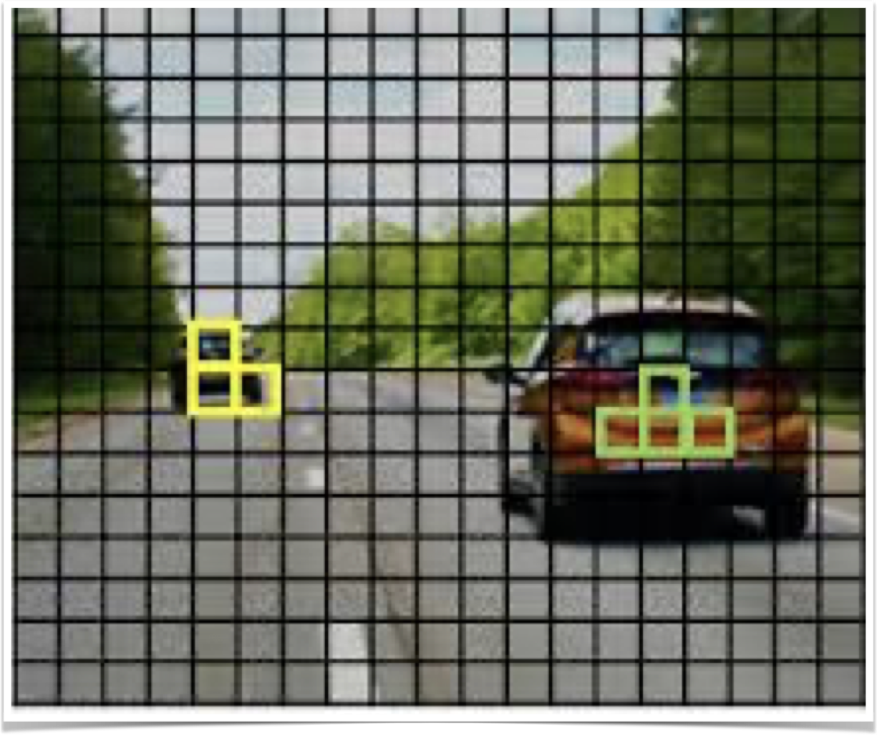
Non-max Suppression
One of the problems of object detection is that our algorithm may find multiple detections of the same objects. Non-max suppression is a way for us to make sure that our algorithm detects each object only once.
Let's say we want to detect pedestrians, cars, and motorcycles in an image. We might place a 19 x 19 grid over it. Now, while technically the car has just one midpoint, so it should be assigned just one grid cell and the car on the left also has just one midpoint, so technically only one of those grid cells should predict that there is a car. In practice, we're running an object classification and localisation algorithm for every one of these split cells.

Slide 25
So it's quite possible that the neighbouring split cells might think that the centre of a car is in them. So, because we're running the image classification and localisation algorithm on every grid cell (361 grid cells), it's possible that many of them will raise their hand and say, "My Pc, my chance of thinking I have an object in it is large." Rather than just having two of the grid cells out of the 361 think they have detected an object. So, when we run our algorithm, we might end up with multiple detections of each object. So, what non-max suppression does, is it cleans up these detections so they end up with just one detection per car, rather than multiple detections per car. Concretely, what it does is, it first looks at the probabilities associated with each of these detections and it first takes the largest one and says, "That's my most confident detection, so let's highlight that and just say I found the car there." Having done that the non-max suppression part then looks at all of the remaining rectangles and all the ones with a high overlap (IoU) with this one that we've just output will get suppressed.
Next, we go through the remaining rectangles and find the one with the highest probability, Pc. So let's commit to that and just say, "Oh, I've detected a car there" and then, the non-max suppression part is to then get rid of any other ones with a high IOU. So now, every rectangle has been either highlighted or darkened and if we just get rid of the darkened rectangles, you are left with just the highlighted ones, and these are our two final predictions. This is non-max suppression and non-max means that we're going to output our maximal probabilities classifications but suppress the close-by ones that are non-maximal. Hence the name, non-max suppression.

Slide 26
First, on this 19 by 19 grid, we're going to get a 19 by 19 by 8 output volume. Although, for this example, I'm going to simplify it to say that we’re only doing car detection. So, I’ll get rid of the C1, C2, C3. Now, to intimate non-max suppression, the first thing we can do is discard all the boxes, discard all the predictions of the bounding boxes with Pc less than or equal to some threshold, let's say 0.6. So we're going to say that unless you think there's at least a 0.6 chance it is an object there, let's just get rid of it. This has caused all of the low probability output boxes. The way to think about this is for each of the 361 positions, we output a bounding box together with a probability of that bounding box being a good one. So we're just going to discard all the bounding boxes that were assigned a low probability. Next, while there are any remaining bounding boxes that we've not yet discarded or processed, we're going to repeatedly pick the box with the highest probability, Pc, and then output that as a prediction. So you commit to outputting that as a prediction. Next, we then discard any remaining box with a high overlap with the box that we just output in the previous step. So, we keep doing this while there's still any remaining boxes that we've not yet processed, until we've taken each of the boxes and either output it as a prediction, or discarded it as having too high an overlap with one of the boxes that we have just output as our predicted position for one of the detected objects.
I've described the algorithm using just a single object. If we actually try to detect three objects say pedestrians, cars, and motorcycles, then the output vector will have three additional components. And it turns out, the right thing to do is to independently carry out non-max suppression three times, one on each of the outputs classes.

Slide 27
Anchor Boxes
One of the problems with object detection is that each of the grid cells can detect only one object. What if a grid cell wants to detect multiple objects? We can use the idea of anchor boxes. Let's say we have an image like this and for this example, I am going to continue to use a 3 by 3 grid. The midpoint of the pedestrian and the midpoint of the car are in almost the same place and both of them fall into the same grid cell. So, for that grid cell, if Y outputs this vector where we are detecting three classes, pedestrians, cars and motorcycles, it won't be able to output two detections. So I have to pick one of the two detections to output. With the idea of anchor boxes, we pre-define two different shapes called, anchor boxes or anchor box shapes (the two rectangles in green) and now, we would be able to associate two predictions with the two anchor boxes.

Slide 28
So what we do is we define the cross label to be, instead of this vector y= [pc bx by bh bw c1 c2 c3]^T, we basically repeat this twice.
So, we will have pc, bx, by, bh, bw, c1, c2, c3, and these are the eight outputs associated with anchor box 1 and then we repeat that pc, bx and so on down to c1, c2, c3, which are the other eight outputs associated with anchor box 2.
Now y= [ pc bx by bh bw c1 c2 c3 pc bx by bh bw c1 c2 c3]^T
ANCHOR BOX 1 ANCHOR BOX 2

Slide 29
So, because the shape of the pedestrian is more similar to the shape of anchor box 1 than anchor box 2, we can use these eight numbers to encode the first pc as one, yes there is a pedestrian. Use the first set of (bx, by, bh, bw) to encode the bounding box around the pedestrian, and then use c1 to encode that that object is a pedestrian.
Since the box around the car is more similar to the shape of anchor box 2 than anchor box 1, we can then use the second pc to encode that the second object here is the car, and have the bounding box and so on be all the parameters associated with the detected car.

Slide 30
Before anchor boxes, we were assigning each object in the training image to a grid cell that contained the object’s midpoint. So the output vector was 3 x 3 x 8. Now, with anchor boxes, each object is assigned to the same grid cell as before, containing the object's midpoint, but it is assigned to a grid cell and anchor box with the highest IoU with the object's shape. The object gets assigned not just to a grid cell but to a pair. It gets assigned to (grid cell, anchor box) pair.
That's how that object gets encoded in the target label. So now, the output Y is going to be 3 x 3 x 16 because Y is now 16 dimensional (there are now 2 anchor boxes and Y is eight dimensional). Dimension of Y being 8 was because we have three objects classes. If we have more objects, then the dimension of Y would be even higher.

Slide 31
For this grid cell, let's specify what is Y. So the pedestrian is more similar to the shape of anchor box 1.
Y pedestrian= [1 bx by bh bw 1 0 0]^T (class 1 is pedestrian)
The shape of the car is more similar to anchor box 2. And so the rest of this vector will be:
Y car = [1 bx by bh bw 0 1 0]^T (class 2 is car)
Y (final output vector) = [1 bx by bh bw 1 0 0 1 bx by bh bw 0 1 0]^T
Bounding box for pedestrian Bounding box for car

Slide 32
Now, what if this grid cell only had a car and had no pedestrian? If it only had a car, then assuming that the shape of the bounding box around the car is still more similar to anchor box 2, the target label Y will still be the same for the anchor box 2 component. But for the part of the vector corresponding to anchor box 1, pc is zero, and then the rest of the components will be don't cares.
Y = [0 ? ? ? ? ? ? ? 1 bx by bh bw 0 1 0]^T
What if we have two anchor boxes but three objects in the same grid cell? That's one case that this algorithm doesn't handle well. Hopefully, it won't happen but if it does, this algorithm doesn't have a great way of handling it.
Or what if we have two objects associated with the same grid cell, but both of them have the same anchor box shape? Again, that's another case that this algorithm doesn't handle well.

Slide 33
The case of what happens if two objects appear in the same grid cell, in practice, that happens quite rarely, especially if we use a 19 by 19 rather than a 3 by 3 grid. The chance of two objects having the same midpoint rather these 361 cells, it does happen, but it doesn't happen that often.
Anchor boxes allow our learning algorithm to specialise better. In particular, if our data set has some tall, skinny objects like pedestrians, and some wide objects like cars, then this allows our learning algorithm to specialise so that some of the outputs can specialise in detecting wide, fat objects like cars, and some of the output units can specialise in detecting tall, skinny objects like pedestrians.
So finally, how do we choose the anchor boxes? People used to just choose them by hand or choose maybe 5 or 10 anchor box shapes that spans a variety of shapes that seems to cover the types of objects you seem to detect. As a much more advanced version and even better way to do this is to use a K-means algorithm, to group together the types of object shapes we tend to get and then to use that to select a set of anchor boxes that this most stereotypically representative of the maybe multiple object classes we're trying to detect.

Slide 34
YOLO Algorithm
First, let's see how we construct our training set. Suppose we're trying to train an algorithm to detect three objects: pedestrians, cars, and motorcycles and we will not need to explicitly have the fourth background class, so just the 3 class labels here. If we're using two anchor boxes, then the outputs y will be 3 x 3 x 2 x 8.

Slide 35
So to construct the training set, we go through each of these nine grid cells and form the appropriate target vector y. So take this first grid cell, there's nothing worth detecting in that grid cell. None of the three classes pedestrian, car and motorcycle, appear in the upper left grid cell and so, the target y corresponding to that grid cell would be equal to:
y = [ 0 ? ? ? ? ? ? ? 0 ? ? ? ? ? ? ?]^T
Where Pc for the first anchor box is zero because there's nothing associated for the first anchor box, and is also zero for the second anchor box and so on. All of these other values are don't cares.

Slide 36
Now most of the grid cells have nothing in them, but for that central box we would have the target vector
y = [0 ? ? ? ? ? ? ? 1 bx by bh bw 0 1 0]^T
So assuming that our training set has a bounding box for the car, it's just a little bit wider than it is tall. Notice then that Pc associated with anchor box one is zero. If we use a 19 x 19 grid and say 5 anchor boxes, the dimensions of the output vector would be 19 x 19 x 5 x 8.
So that's training and we train ConvNet that inputs an image, maybe 100 x 100 x 3, and our ConvNet would then finally output the output volume 3 x 3 x 16 in our example.

Slide 37
Next, let's look at how our algorithm can make predictions. Our neural network can't output a question mark or a don't care. So I'll put some numbers for the rest. But these numbers will basically be ignored because the neural network is telling you that there's no object there. So it doesn't really matter whether the output is a bounding box. So basically there would just be some set of numbers, more or less noise. In contrast, for the box containing the car hopefully, the value of y would be something like zero for bounding box one and then just output a bunch of numbers, just noise. Hopefully, it'll also output a set of numbers that corresponds to specifying a pretty accurate bounding box for the car. So that's how the neural network will make predictions. Finally, we run this through non-max suppression. Here's how we would run non-max suppression.

Slide 39
If we're using two anchor boxes, then for each of the nine grid cells, we get two predicted bounding boxes. Some of them will have very low probability (Pc), but we still get two predicted bounding boxes for each of the nine grid cells. Some of the bounding boxes can go outside the height and width of the grid cell that they came from. Next, we then get rid of the low probability predictions. So get rid of the ones that even the neural network says, “this object probably isn't there”. Then finally if we have three classes we're trying to detect, what we do is, for each of the three classes, we independently run non-max suppression for the objects that were predicted to come from that class. So the output of this is hopefully that we will have detected all the cars and all the pedestrians in this image. This was YOLO object detection algorithm which is really one of the most effective object detection algorithms, that also encompasses many of the best ideas across the entire computer vision literature that relate to object detection.

Slide 40
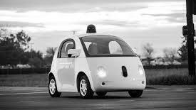
Thank you

